Slide 1
The Power of the Purse
Congressional power to collect taxes and oversee discretionary spending
Provides checks and balances; hedge against excessive presidential ambition
Allows a deliberative body to manage finances
Congressional committees hold keys to spending on defense, international affairs, and foreign assistance
Negotiations between executive agencies, congressional committees, and White House
Notes:
Learning Objective: 5.5

Slide 2
Managing the Defense Budget
Largest share of spending to national defense, increased after 9/11
Guns-or-butter debates: Military vs. domestic spending debates
Disagreements between president and Congress over spending, each with own budget plans and offices
Problems with iron triangles and overpriced military expenditures
Pork-barrel politics: Representatives secure military and other projects for their home districts
Conflict since end of Cold War over supply and weaponry companies/plants
2009 appropriations bill passed under Obama administration noted U.S. forces should be prepared for unconventional wars of the future rather than superpower showdowns of the Cold War
Notes:
Learning Objective: 5.5

Slide 3
The Price of Diplomacy
International affairs budget: Includes State Department and foreign aid, but less than 2% of federal budget in 2009
Diplomacy not as valued as defense in political culture and history
Debates on the value of diplomacy
Since 9/11, more interest in Congress in the soft power of nonmilitary international programs, such as aid, training, and overseas diplomacy
Continuation of enhancing soft power tools under Obama
Goal of rebuilding trust internationally
Notes:
Learning Objective: 5.5

Slide 4
Conclusion
Fragmentation and diffusion of government power, of which legislative–executive relations is but one element, ensure the erratic exercise of world power by the United States.
War strengthens the executive branch and rewards congressional deference.
However, mutual legislative–executive accommodation is best for an orderly foreign policy process.

Slide 5
Chapter Objectives:
Summarize the role of the US foreign policy bureaucracy
Describe the conduct of US diplomacy and three criticisms of its practice
Discuss the institutions that comprise the US security complex
Explain the work of and challenges facing the US intelligence complex
Describe the role of key players in the conduct of US foreign economic policy.

Slide 6
The Foreign Policy Bureaucracy
Large and growing foreign policy bureaucracy
Formulation and implementation
Overlapping jurisdictions and missions
Fragmented political system and dispersion of authority
Vertical: Among local, state, and federal agencies
Horizontal: Across the three branches of government
Internal: Inside bureaucracies and agencies
Notes:
Learning Objective number: 6.1

Slide 7
The Foreign Policy Bureaucracy
Three reasons for bureaucratic power
Congressional deference
Executive branch and agencies given widespread authority and power in foreign policy
White House constraints
Presidents have limited time, resources, and desire to supervise foreign policy bureaucrats
Organizational expertise
Specialization by and experience of foreign policy agents leads to hands-off approach of elected officials unless large problems occur
Notes:
Learning Objective number: 6.1

Slide 8
The Foreign Policy Bureaucracy
Path dependency
Bureaucracy is also dependent on past structural choices, informed by their architects’ values and goals, which push future policies in particular directions
Four bureaucratic complexes
Security
Intelligence
Economic
Diplomatic
Notes:
Learning Objective number: 6.1
What does pat-dependency mean? In your own words.
Is this a good thing or a bad thing?

Slide 9
Discussion question:
Generally speaking, do you have a favorable or unfavorable view of bureaucracy:
Favorable
Unfavorable
Neither

Slide 10
Agency Functions and the Paradox of World Power
Positive functions of bureaucracies?
Stability
Continuity
Constancy
Negative functions of bureaucracies?
Turf wars over policy authority
Fragmentation of bureaucratic authority due to . .
Clashing goals
Dominant self-interests
Overlapping responsibilities
Notes:
Learning Objective number: 6.1

Slide 11
Agency Functions and the Paradox of World Power
Clashing organizational cultures
Each organization and agency has its own organizational culture (shared values, goals, and priorities)
Each organization has its own history and mission
Clash of cultures leads to difficulty in foreign policy making
Each organization maintains its sense of superiority in organizational function and culture
Notes:
Learning Objective number: 6.1

Slide 12
The Diplomatic Complex
Diplomacy: Interaction among sovereign states regarding policy areas of mutual concern or cooperation
Diplomacy is time-consuming and long-term for stable relationships
Builds allies and partners in a transnational society
Cultural and institutional difficulties for diplomacy
Early desires to defect from European “statecraft” and foreign alliances
Only recent increases in foreign service funding and expansion
Low State Department budget, salary, and personnel levels
Notes:
Learning Objective number: 6.2

Slide 13
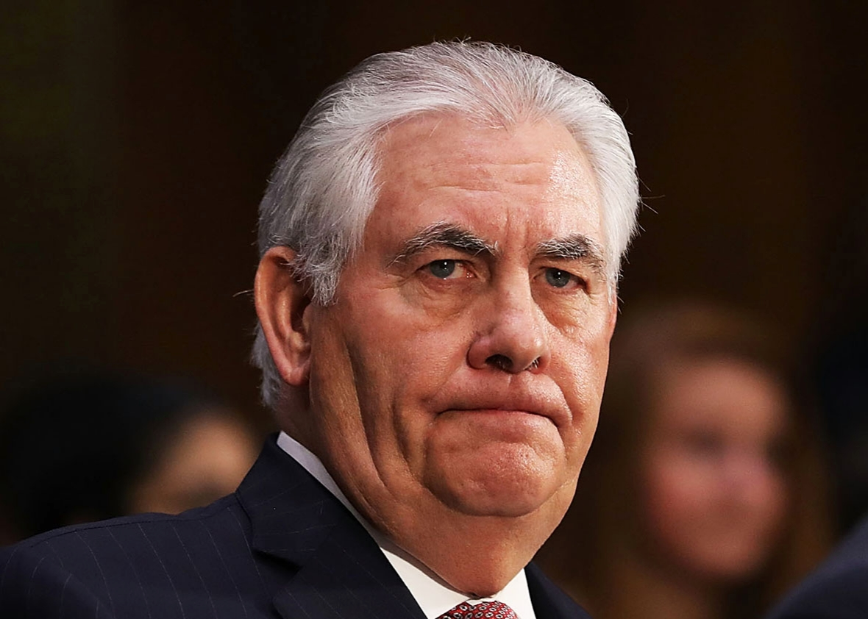
Criticism and Reform at Foggy Bottom
Growing separation of branches
Centralization of foreign affairs in the White House
Security emphasized more than diplomacy
Culture of disdain for diplomacy
Public opinion tends to support domestic rather than foreign affairs (misunderstanding of amount spent on foreign affairs)
Diplomats and foreign service officers are seen as elitists, resistant to change; sometimes accused of protecting interests of foreign countries instead of U.S. national interests (clientitis)
Notes:
Learning Objective number: 6.2

Slide 14
Criticism and Reform at Foggy Bottom
Institutional problems
Divided within Department of State
Budget and resource cutbacks
Lack of support in Congress
Morale problem: Battles among the secretary of state, national security adviser, and secretary of defense
Example—Iraq war and reconstruction: State vs. Defense, Pentagon vs. National Security Council
Notes:
Learning Objective number: 6.2

Slide 15
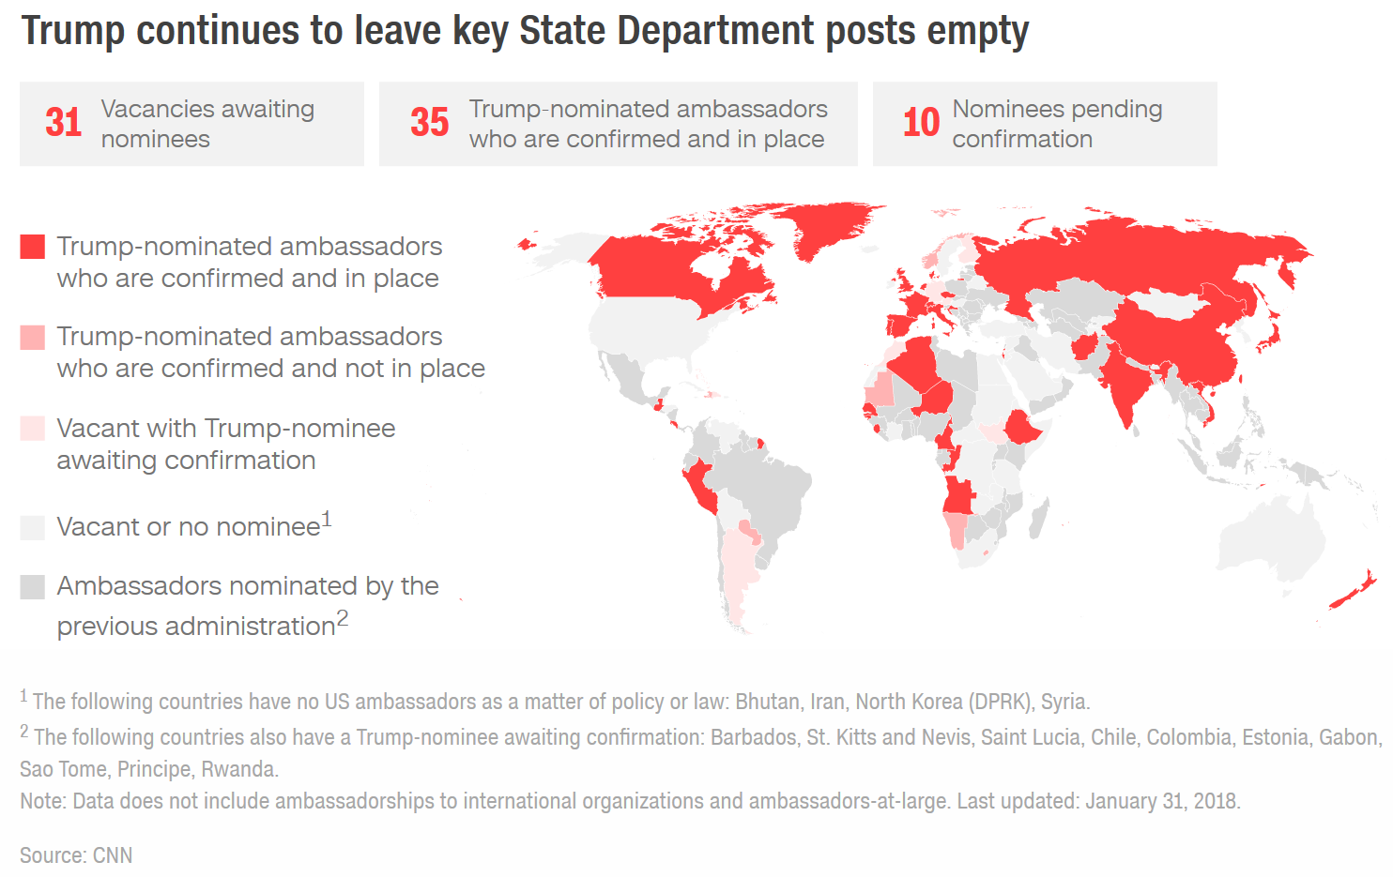

Slide 16
National Security Council
Ad hoc institution of members from a variety of agencies
Very malleable
Its shape and role change with each president and policy issue
Members attend meetings involving their areas of expertise
Led by national security adviser (NSA)
NSA’s role and level of involvement varies by issue and president
Often not neutral and may be more of a policy advocate, such as Kissinger
Serves a variety of functions
Agent of policy coordination
Policy guidance and investigation
Policy and crisis management
Notes:
Learning Objective number: 6.3
Originally meant to streamline the security policy process, has since become very active and promotes its of policy preferences, another voice in the room.

Slide 17
National Security Council
An independent, often secretive agency that has policy goals and is not neutral
Lack of information and coordination with Congress leaves the public out
Concentration of White House bureaucracy leaves the Pentagon out of security policy
Concerns about potential abuses from concentration of presidential power
Example: Paramilitary operations in Central America and Middle East in 1980s
Notes:
Learning Objective number: 6.3

Slide 18
Department of Defense
Largest, most expansive agency
Growing budget (close to $1 trillion) and staff (700,000 civilians)
Complex structure and roles
Directed by secretary of defense, who is advised by the Joint Chiefs of Staff (JCS)
Military establishment
Lack of reform in capabilities, even after the end of the Cold War with bottom-up review in 1993
Transformation politics
Internal politics with base and factory closings
Difficulty with troop reductions and relocations
Secretary Rumsfeld led a buildup in capabilities and missions after 9/11
Obama administration has shifted to strategy of smaller military “footprint” in conflict zones; moving away from counterinsurgency strategies
Notes:
Learning Objective number: 6.3

Slide 19
Department of Homeland Security
Created following the 9/11 attacks to protect domestic interests and safety of public
Massive consolidation of dozens of federal agencies under the DHS umbrella
Coast Guard, Customs, Secret Service, Citizenship and Immigration Services, Transportation Security, and Federal Emergency Management Agency (FEMA)
Third-largest among federal agencies in personnel with 180,000+ under umbrella
Difficulty of combining agencies and shuffling their staff and missions
Ambiguous and blurred overall mission of protecting homeland
Critiques of pork barrel politics in contracts and funding
Notes:
Learning Objective number: 6.3

Slide 20
Conclusion
Fragmented U.S. foreign policy bureaucracy in each functional complex
Centralization of authority and influence in positions inside the White House over the years
Disconnects between goals and implementation
Concerns about oversight and reliability
September 11 exemplifies all of these paradoxes and concerns

